Slide 1
Data Science Lifecycle
The Data Science Lifecycle represents a structured, iterative workflow designed to transform raw data into actionable intelligence. It ensures that data projects are not just mathematical exercises, but practical tools that solve real-world problems.
Step 1 – Problem Understanding
Step 2 – Data Collection
Step 3 – Data Cleaning
Step 4 – Exploratory Data Analysis (EDA)
Step 5 – Modeling
Step 6 – Evaluation
Step 7 – Deployment

Slide 2
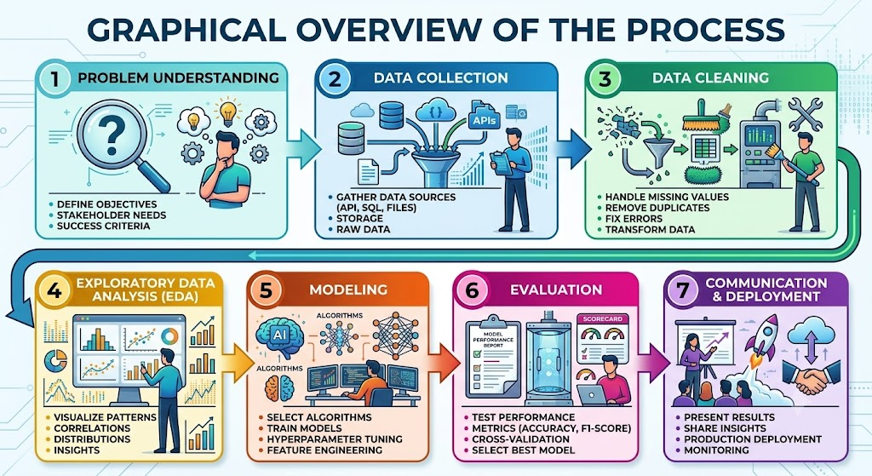

Slide 3
Data Science Lifecycle
Step 1 – Problem Understanding
Before writing a single line of code or querying a database, you must clearly frame the problem you are trying to solve.
Define Objectives: Translate vague business goals into precise, measurable data science tasks. (e.g., instead of "We need to increase sales," define the objective as "Predict which customer cohorts are likely to churn next quarter with an F1 score of 0.85").
Understand Stakeholders: Identify who will use the final model or insight. A model built for automated software infrastructure requires different parameters than an analytics dashboard designed for high-level executives.

Slide 4
Data Science Lifecycle
Step 2 – Data Collection
Once you know the destination, you need to gather the raw materials. Data scientists pull from a vast array of digital sources.
Databases: Querying structured corporate data lakes and relational databases using SQL.
APIs: Connecting to third-party live application programming interfaces to ingest streaming data (e.g., financial market tickers, weather feeds, or social media text streams).
Surveys: Designing direct sampling mechanisms to capture targeted, human-centric qualitative and quantitative metrics.
Web Scraping: Utilizing automated parsers (like Beautiful Soup or Scrapy) to extract unstructured information from across the web when public APIs are unavailable.

Slide 5
Data Science Lifecycle
Step 3 – Data Cleaning
Raw data is notoriously messy. In fact, data professionals frequently spend up to 70% of their project time in this phase, preparing the dataset for analysis.
Missing Values: Deciding whether to drop rows with missing records or systematically calculate replacements using statistical imputation (like mean, median, or K-Nearest Neighbors).
Duplicates: Locating and purging redundant or overlapping database entries to prevent artificially biasing the machine learning model.
Errors: Correcting glaring anomalies, corrupted text strings, invalid data types, or extreme structural out-of-bounds outliers caused by sensor malfunctions or human entry mistakes.

Slide 6
Data Science Lifecycle
Step 4 – Exploratory Data Analysis (EDA)
EDA is the stage where you listen to your data to uncover hidden anomalies, behaviors, and initial correlations.
Summaries: Utilizing descriptive statistics—calculating the mean, median, standard deviation, and interquartile ranges—to understand the geometric distribution of the data.
Visualizations: Plotting the variables using histograms, scatter plots, and box plots to see how variables interact with one another.
Pattern Discovery: Identifying initial structural trends, feature correlations, and data distributions that will dictate which machine learning models are best suited for the next phase.

Slide 7
Data Science Lifecycle
Step 5 – Modeling
This is the mathematical core of the lifecycle. Here, you select and train mathematical algorithms to learn from the cleaned patterns exposed during EDA.
Regression: Training models to predict a continuous numerical value (e.g., forecasting next month's revenue or crop yield).
Classification: Building algorithms to sort items into distinct categorical buckets (e.g., flagging an incoming email as "Spam" vs. "Ham", or labeling an image as "Cat" vs. "Dog").
Clustering: Utilizing unsupervised algorithms (like K-Means) to automatically discover natural groupings within an unlabelled dataset (e.g., identifying distinct customer persona segments).

Slide 8
Data Science Lifecycle
Step 6 – Evaluation
A model is only as good as its performance on data it has never seen before. This step protects the project against overfitting (where a model memorizes training data but fails in the real world).
Validation: Splitting data into distinct training and testing sets, or utilizing cross-validation techniques, to rigidly benchmark the model against unseen inputs.
Performance Metrics: Calculating domain-specific diagnostic values, such as:
  Accuracy, Precision, and Recall for classification models.
  Mean Squared Error (MSE) or R^2 scores for regression models.

Slide 9
Data Science Lifecycle
Step 7 – Deployment
The ultimate goal of data science is to drive real-world transformation. If your insights stay locked inside an isolated computational environment, the lifecycle is incomplete.
Reports & Dashboards: Packaging complex technical conclusions into clear visual mediums (like Tableau, Power BI, or interactive applications) so non-technical stakeholders can easily digest the findings.
Business Decisions / Production Deployment: Integrating the final machine learning model directly into live operational pipelines. This allows the system to automatically trigger autonomous actions—such as routing smart city traffic, blocking fraudulent transactions, or tailoring personalized e-commerce interfaces.

Slide 10
Data Science Lifecycle
The Iterative Loop: Crucially, this process is rarely a straight line. If evaluation metrics fall short in Step 6, the team loops back to Step 5 to optimize algorithms, or back to Step 2 & 3 to collect cleaner, more representative data.
In practice, it is often beneficial to perform Exploratory Data Analysis (EDA) both before and after data cleaning.
Initial EDA helps identify data quality issues such as missing values, outliers, inconsistencies, and duplicates, which can then be addressed during the data cleaning phase.
Performing EDA again after cleaning allows analysts to verify the effectiveness of the cleaning process and gain more reliable insights from the refined dataset..
Step 1 – Problem Understanding
↓
Step 2 – Data Collection
↓
Step 3 – Data Cleaning
↓
Step 4 – EDA
↓
Step 5 – Modeling
↓
Step 6 – Evaluation
↓
Step 7 – Deployment
EDA

